Slide 1

A Presentation on Ishtehaar : The Job Portal App
Guided by: Mr. Neeraj Khanna
Submitted By: Nishant Kumar Singh (161500363)
Rishabh Singh (161500452)
Mukesh Kumar Maurya(161500330)

Slide 2
Introduction
Ishtehaar is an android application which acts as a portal between Job Seekers and Recruiters. It is helpful for freshers as well as young graduates, to get stated with their career.
Using Ishtehaar, one can search job matching his or her qualification and appear for the selection process once the application is being registered and accepted.

Slide 3
Objectives
The Objective of Ishtehaar is to provide a platform for young graduates and freshers to find the right and satisfactory job according to their qualification.
It connects Job Seekers to recruiters by accurately matching candidate's profile to the relevant job openings through an advanced 2-way matching technology which works by matching candidates qualification to recruiters requirements.
Ishtehaar is developed with an eye to bridge the gap between talent and opportunities and offers end-to-end recruitment solutions. Job Vibe brings candidate and top employees under one roof.

Slide 4
Existing System
The existing system requires applicants to search through print and visual media for job opportunities.
Applicants need to apply for jobs using conventional methods and wait for further details for a long period of time.
Employers need to advertise the vacancies and sort all applicant details, conduct selection procedures and complete the formalities.
This approach is tedious and requires much effort and resources.

Slide 5
Proposed System
Simple and professional GUI for all qualification groups.
All vacancies are available on a single interface.
Job Seekers can save jobs according to their requirement.
Reduce paper work and extra cost.
Filer and search facility for job seekers according to their requirement.
Applicant gets instant response for any query through notification and other media.

Slide 6
External Interface Requirement
Hardware Interface:-
The application will run on an Android emulator or an Android mobile device with the following specifications: -
Processor: - 1.2GHz or above.
RAM: - 2GB or above.
Internal Storage: - 4GB or above.
Software Interface: -
The software will run on the Android operating system, specifically version 5.0 (Lollipop) and above.

Slide 7
Tools & Languages Used
Language Used: -
Java
XML
SQLite
Software Used: -
Android Studio
GitHub

Slide 8
Data Flow Diagram

Slide 9
LEVEL 0 DFD

Slide 10
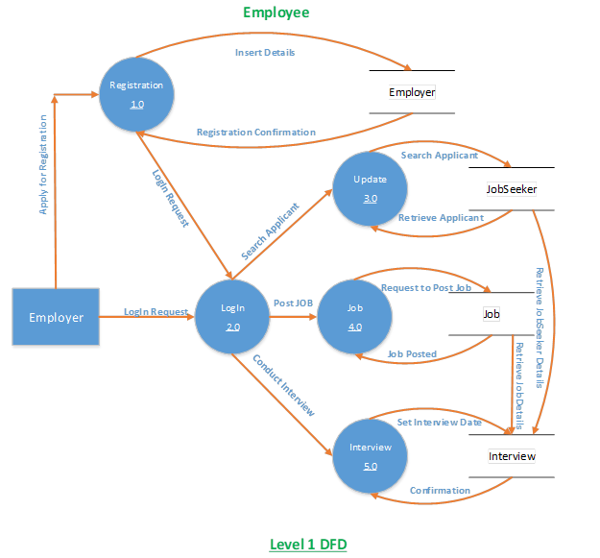
LEVEL 1 DFD

Slide 11
LEVEL 1 DFD

Slide 12
ER Diagram

Slide 13
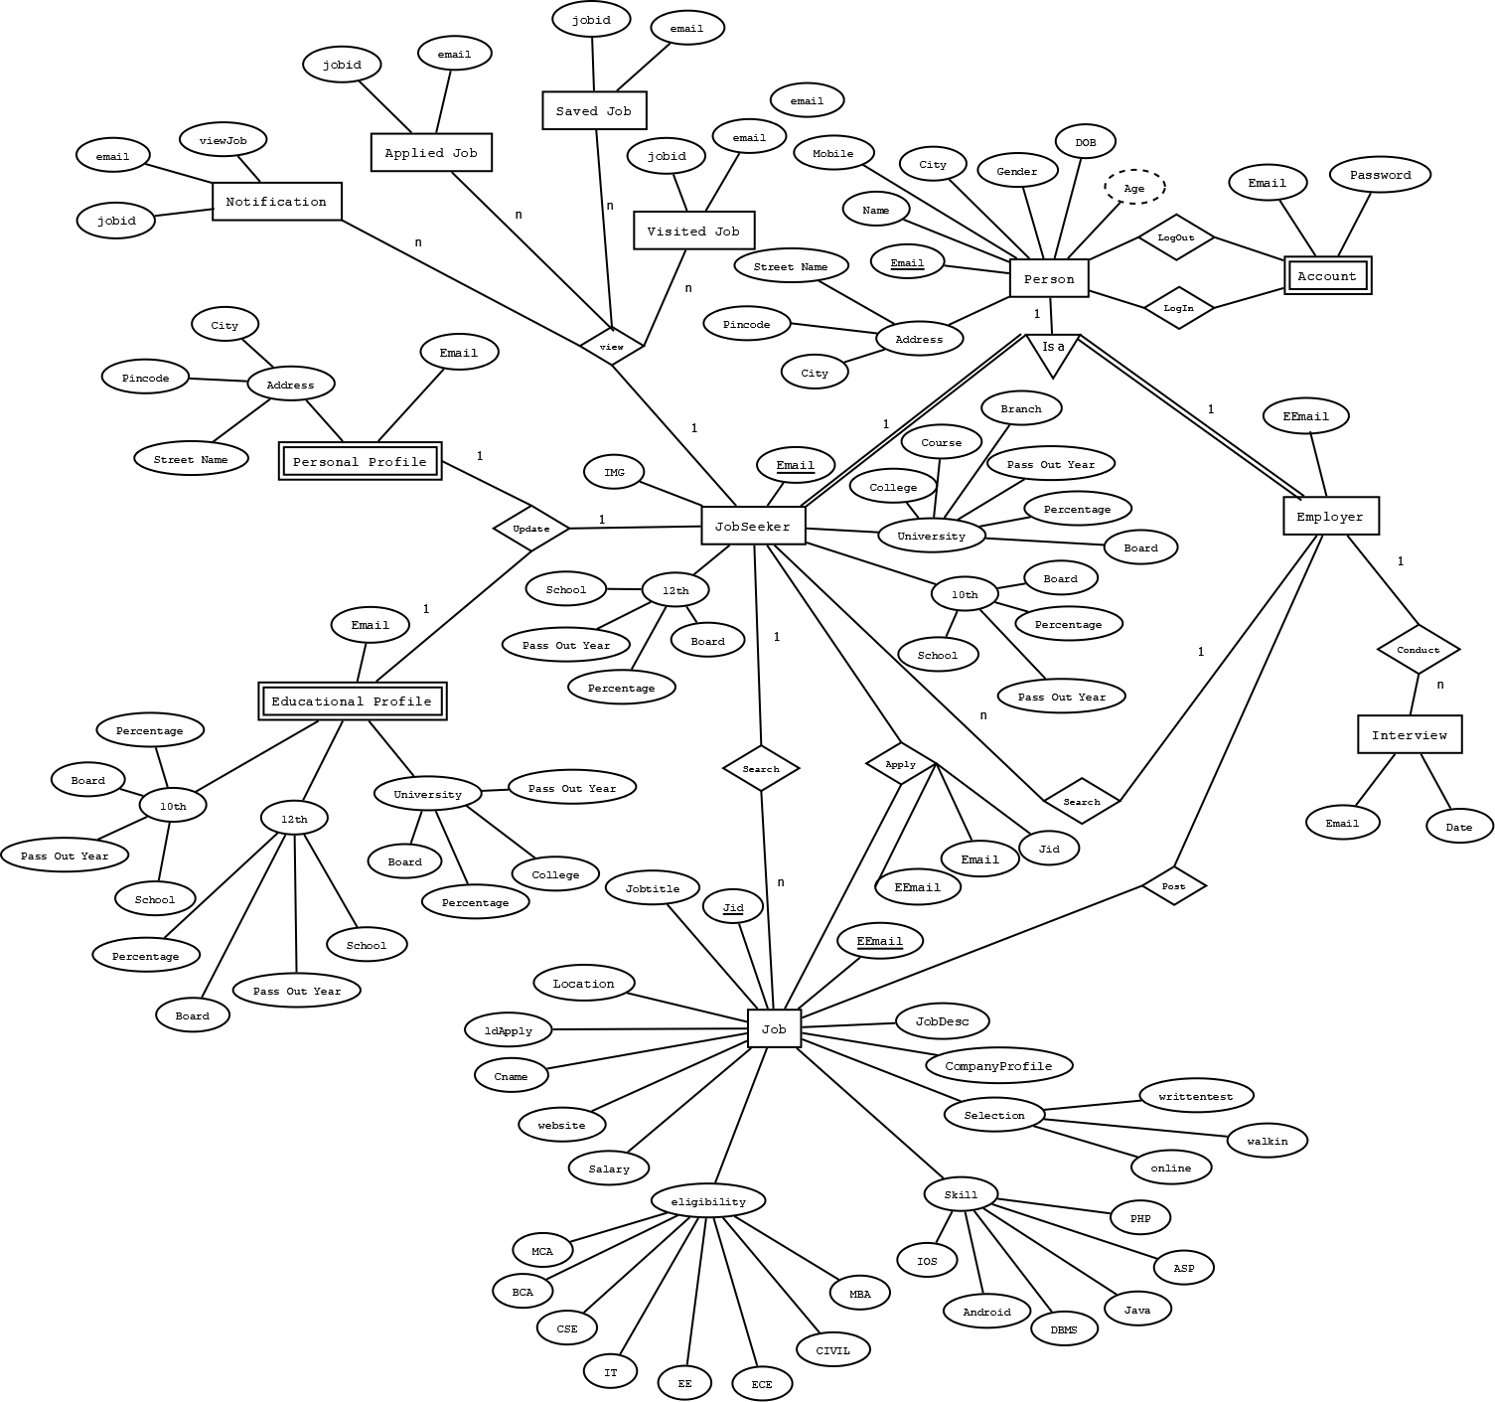

Slide 14
Relational Model

Slide 15
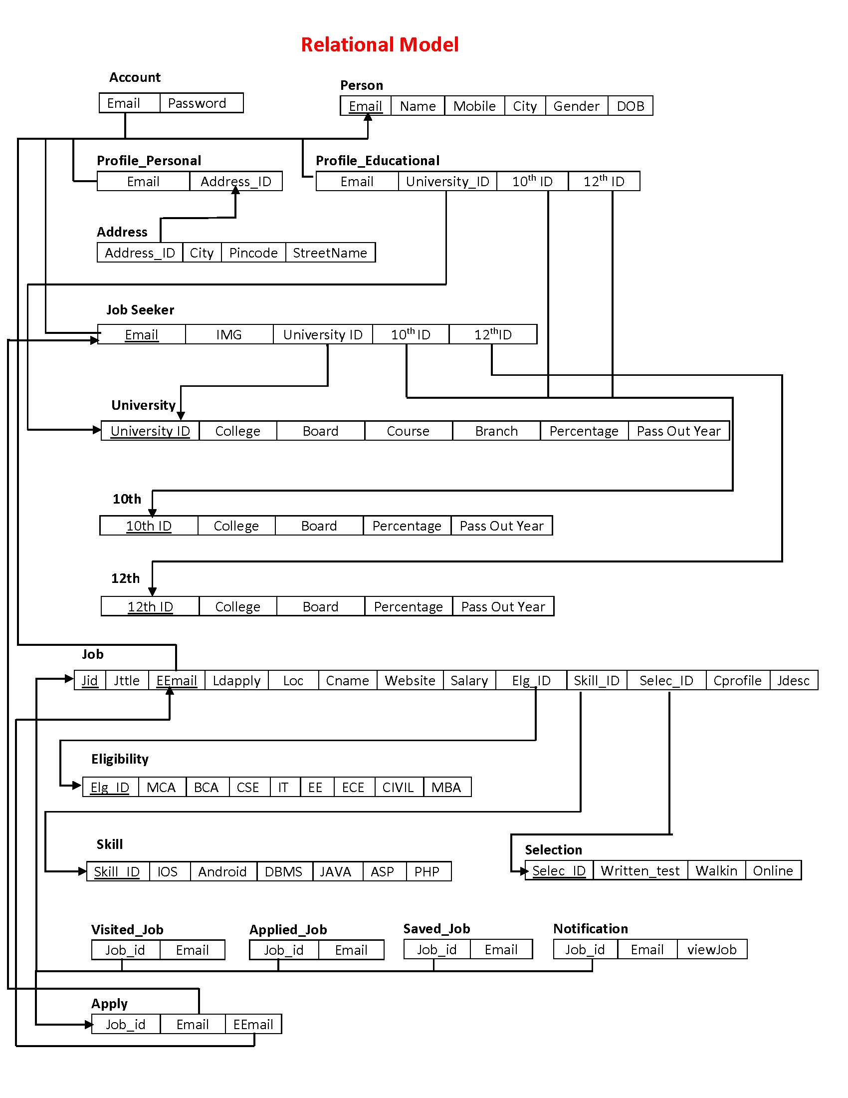

Slide 16
Screenshots

Slide 17

Flash Screen

Slide 18
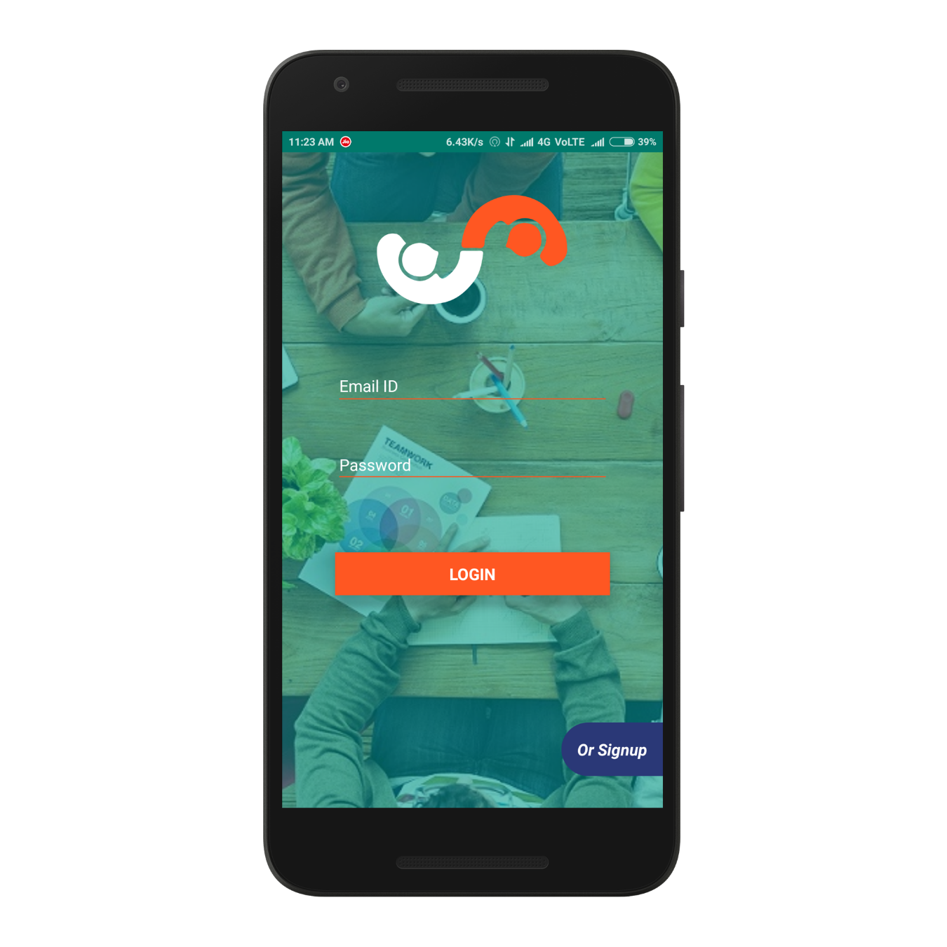
Login

Slide 19
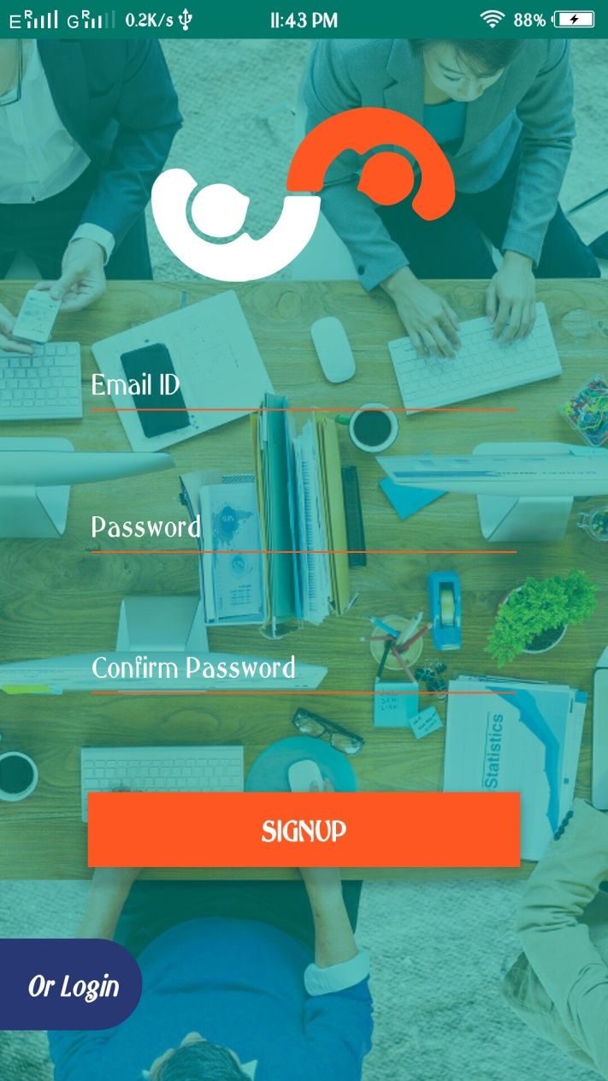
Signup

Slide 20
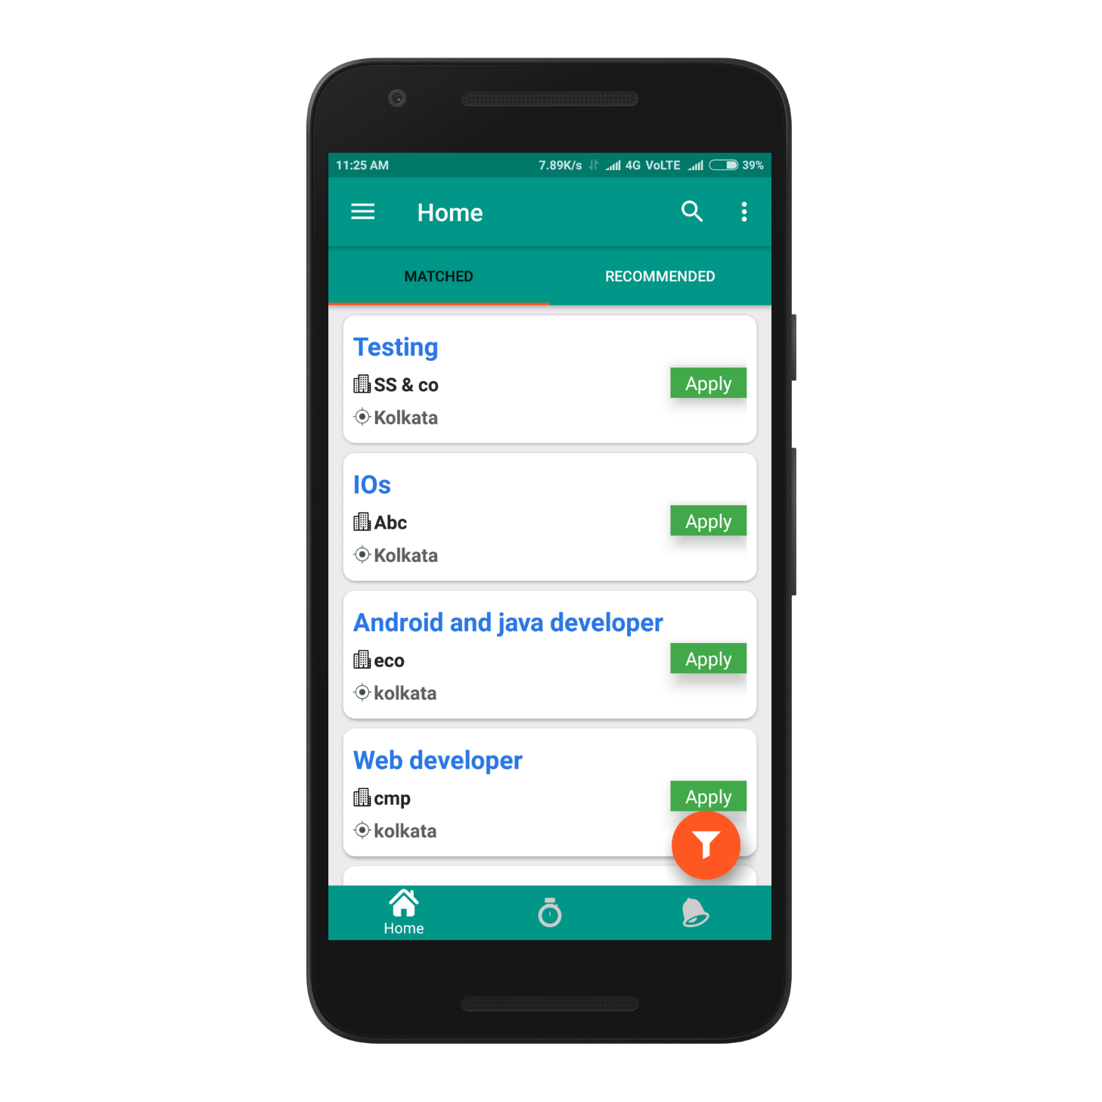
Home

Slide 21
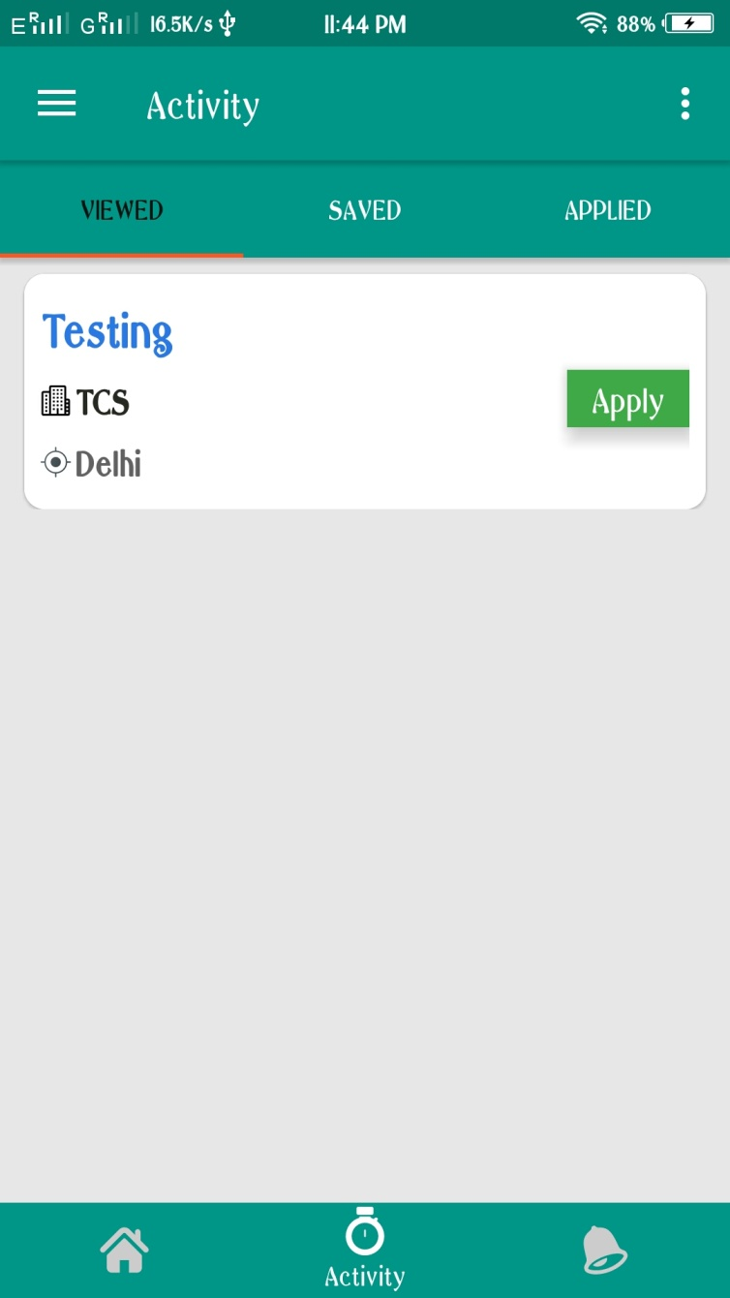
Activity

Slide 22
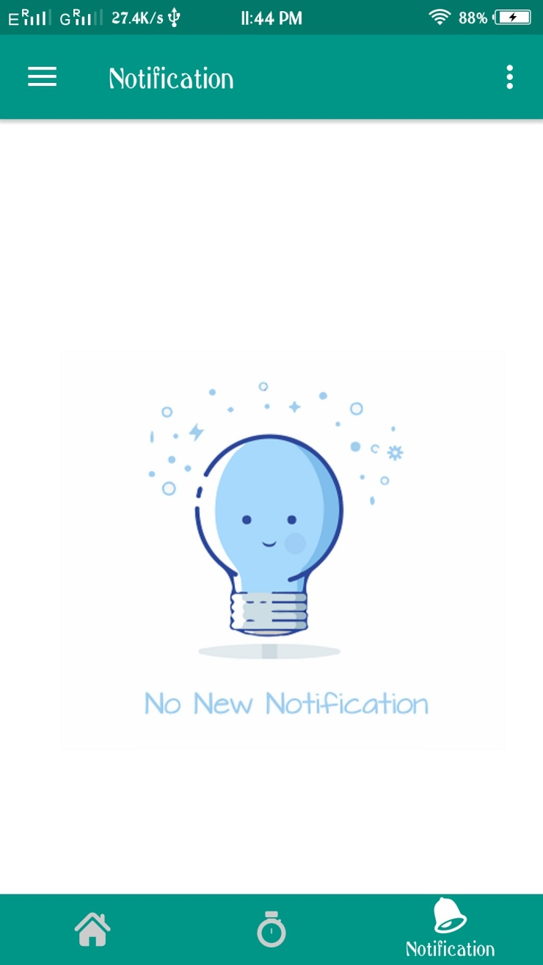
Notification

Slide 23
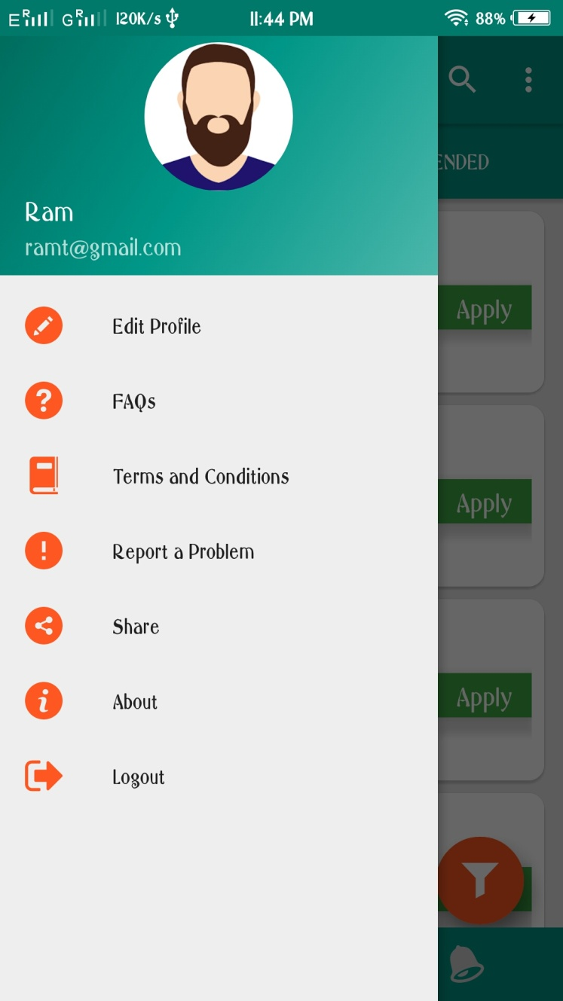
Menu

Slide 24
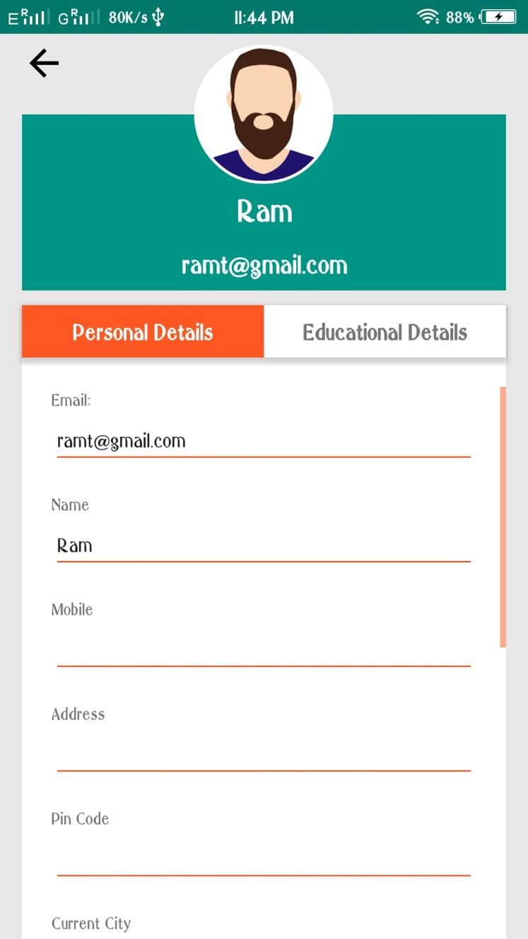
Profile

Slide 25
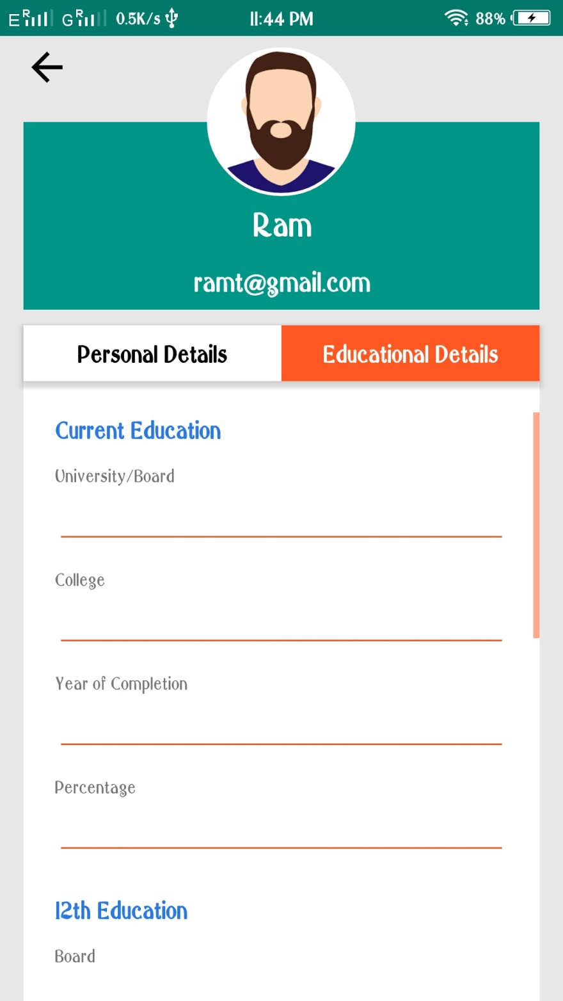

Slide 26
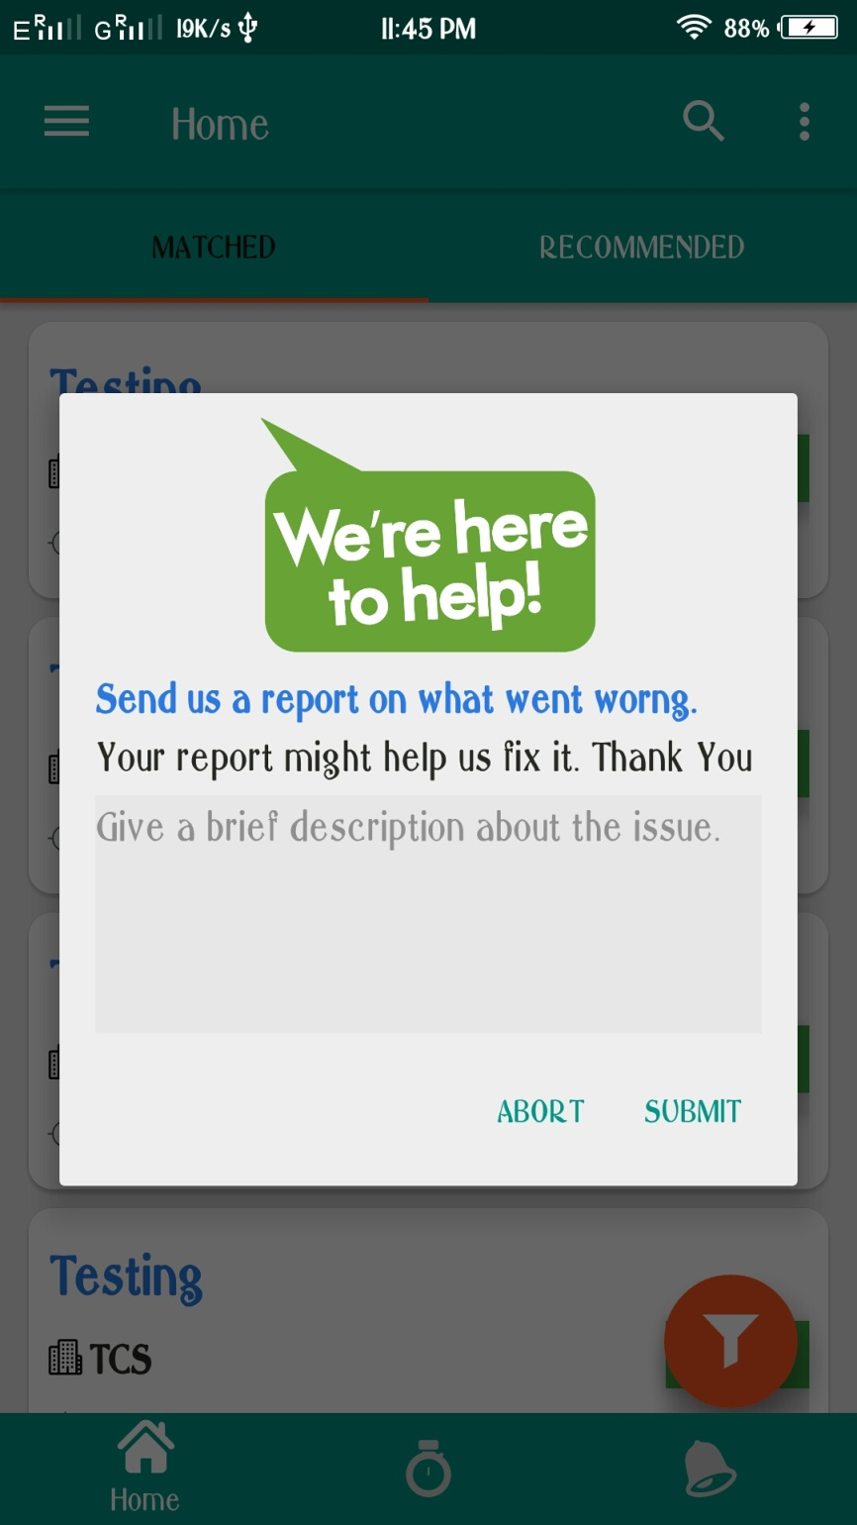

Slide 27
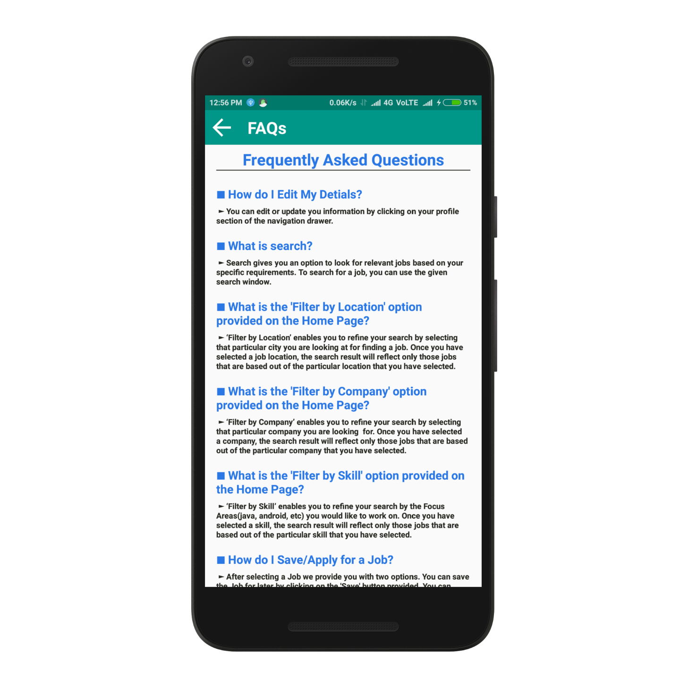
FAQs

Slide 28
THANK YOU & HAVE A GREAT DAY AHEAD!

